Slide 1

Expect the Unexpected
Kito D. Mann
Principal Consultant

Slide 2
Expect the unexpected
Kito D. Mann
Principal Consultant

Slide 3

Kito D. Mann
@kito99
Principal Consultant at Virtua
  http://www.virtua.com
  Training, consulting, architecture, mentoring,
  JSF product development
Author, JavaServer Faces in Action
Founder, JSF Central
  http://www.jsfcentral.com
Internationally recognized speaker
  JavaOne, JavaZone, Devoxx, NFJS, TSSJS, etc.

Slide 4
Kito D. Mann
@kito99
JCP Member
  JSF, WebBeans, JSF Portlet Bridge, Portlets

Slide 5
bad things happen

Slide 6
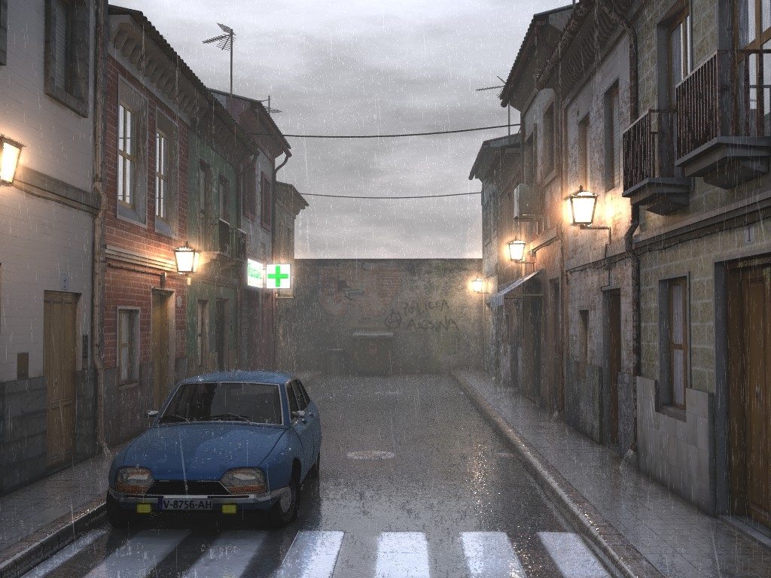

Slide 7
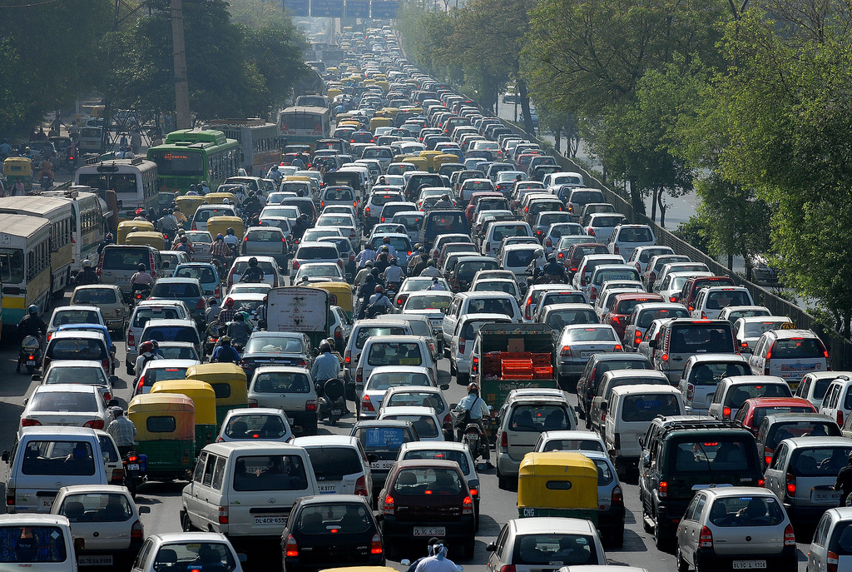

Slide 8
“that should never happen”

Slide 9
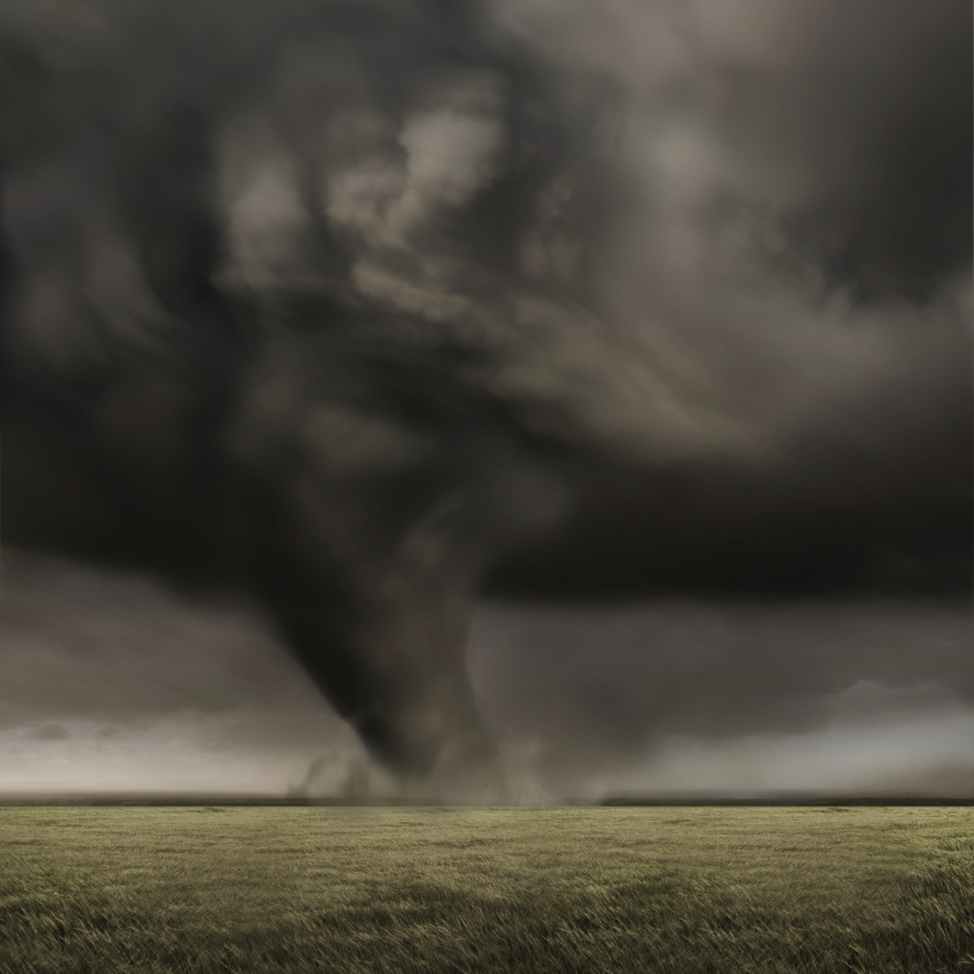

Slide 10
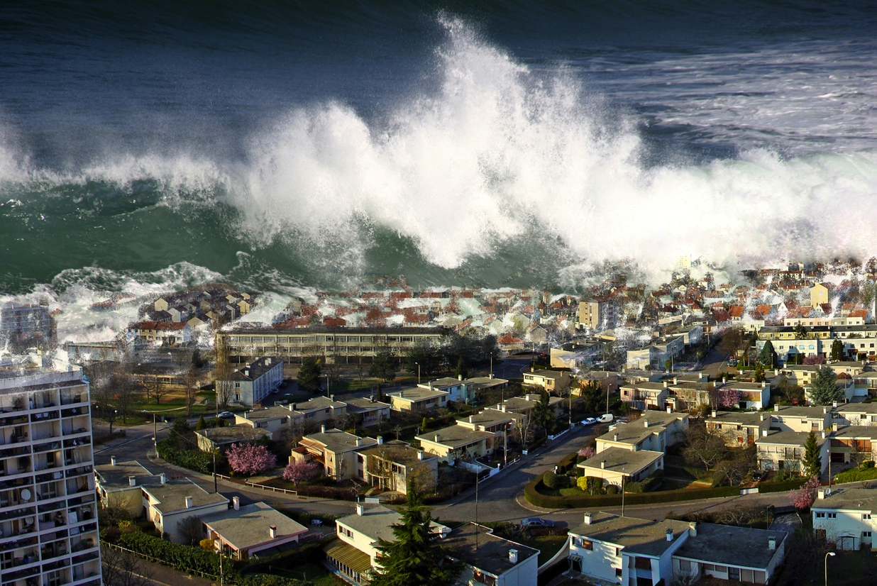

Slide 11
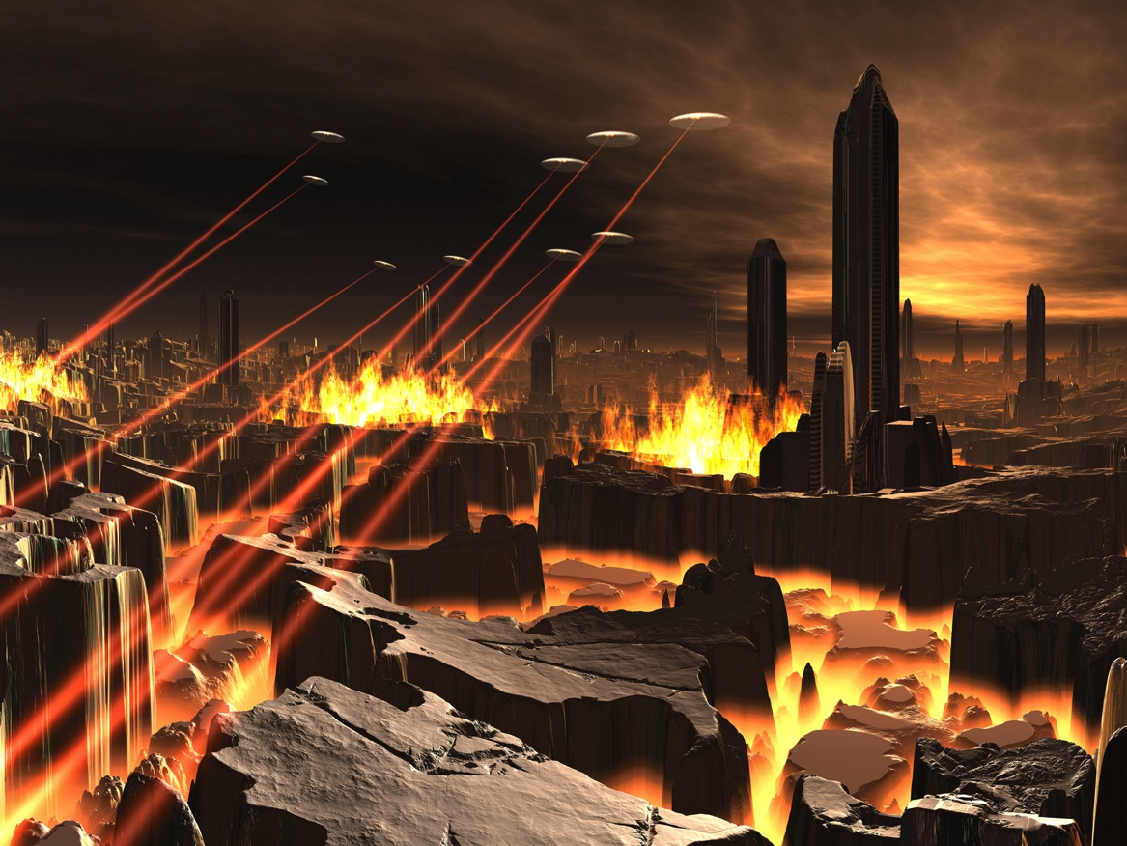

Slide 12
some bad things seem minor

Slide 13
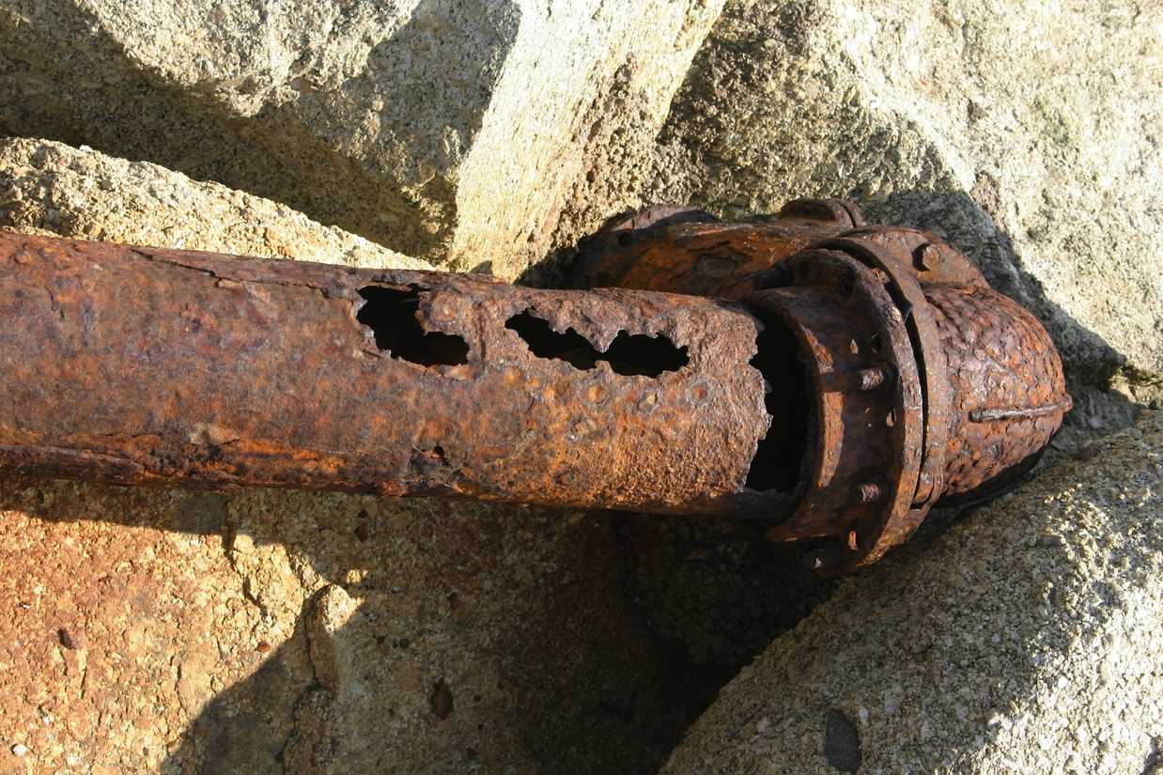

Slide 14
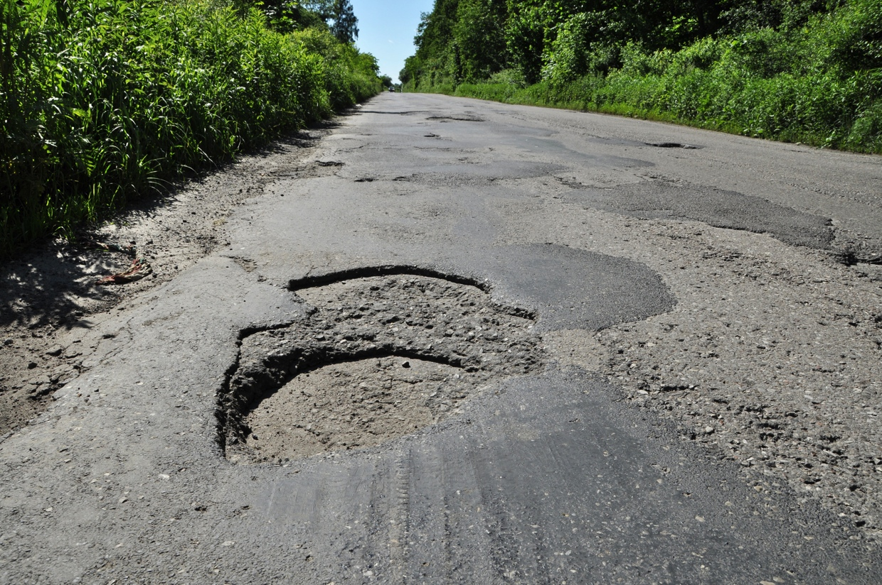

Slide 15
ex·cep·tion
noun. something excepted; an instance or case not conforming to the general rule.

Slide 16
expect bad things

Slide 17
regardless of the what is happening, your application should be in a consistent state.
Notes:
#1 thing: user experiece
Ask yourself what would happen if this call fails

Slide 18
exception handling aphorisms
Notes:
#1 thing: user experiece
Ask yourself what would happen if this call fails

Slide 19


Slide 20
don't eat exceptions
Notes:
#1 thing: user experiece
Ask yourself what would happen if this call fails

Slide 21
public void save() {
try {
getWidgetProvider().add(selectedWidget);
} catch (DatabaseException e) {
e.printStackTrace();
}
display("Your widget has been created successfully.");
setSelectedWidget(null);
}

Slide 22
if you can recover from it, catch it and tell the user (if necessary)

Slide 23
public void save() throws DatabaseException {
try {
getWidgetProvider().add(selectedWidget);
display("Your widget has been created successfully");
setSelectedWidget(null);
} catch (DatabaseException e) {
displayError("Sorry, a database error has occurred. Please try again later.");
logger.log(Level.SEVERE, "Error accessing the database", e);
}
}

Slide 24
if you cannot recover from it, don't catch it
Notes:
#1 thing: user experiece
Ask yourself what would happen if this call fails

Slide 25
public void save() throws DatabaseException {
getWidgetProvider().add(selectedWidget);
display("Your widget has been created successfully");
setSelectedWidget(null);
}

Slide 26
demo
Notes:
Demo unexpected app
Show WidgetViewerBean.save(()
Demo expected app
Show WidgetViewerBean.save() and unrecoverableSave()

Slide 27
for any call, if something goes wrong, ensure consistency
Notes:
Try/finally Close connections, cleanup

Slide 28
try {
session = openSession();
if (rule.isCachedModel() || BatchSessionUtil.isEnabled()) {
Object staleObject = session.get(RuleImpl.class,
rule.getPrimaryKeyObj());
if (staleObject != null) {
session.evict(staleObject);
}
}
session.delete(rule);
session.flush();
}
catch (Exception e) {
throw processException(e);
}
finally {
closeSession(session);
}

Slide 29
use a logging framework consistently
Notes:
System.out.println is not a logging framework.
Consistent output
Output formatting – date, time, thread, method, etc.
Control over output location
Additional appender types (i.e. e-mail or SMS)

Slide 30
do not log an exception more than one time

Slide 31
demo
Notes:
Run unexpected save again
View stack trace
Follow exceptions from WidgetViewerBean.save() down through stack to NotificationEngine

Slide 32
throw meaningful exceptions
Notes:
Develop your own hierarchy
Consider unchecked exceptions

Slide 34
centralize exception handling

Slide 35
centralize exception handling
Logging
Notifications
Error page
Notes:
Handle exceptions the closest to the user

Slide 36
web.xml
<web-app … version="3.0">
…
<error-page>
<exception-type>
java.lang.Throwable
</exception-type>
<location>/error.jsf</location>
</error-page>
</web-app>

Slide 37
JSF 2
public class CustomExceptionHandler extends
ExceptionHandlerWrapper {
private static final Logger logger = Logger
.getLogger(WidgetViewerBean.class.getName());
private ExceptionHandler wrapped;
public CustomExceptionHandler(ExceptionHandler wrapped) {
this.wrapped = wrapped;
}

Slide 38
JSF 2
@Override
public void handle() throws FacesException {
Iterator<ExceptionQueuedEvent> i =
getUnhandledExceptionQueuedEvents()
.iterator();
while (i.hasNext()) {
ExceptionQueuedEvent event = i.next();
ExceptionQueuedEventContext context = (ExceptionQueuedEventContext) event
.getSource();
Throwable t = context.getException();
try {
logger.log(Level.SEVERE,
"Serious error happened!", t);
} finally {
i.remove();
}
}
getWrapped().handle();
}

Slide 39
JSF 2
@Override
public ExceptionHandler getWrapped() {
return this.wrapped;
}
}

Slide 40
CDI – Apache DeltaSpike
@ExceptionHandler
public class MyHandlers {
void logExceptions(@Handles
@WebRequest CaughtException<Throwable> evt,
Logger log) {
log.error("Something bad happened!”, evt.getException());
}
}

Slide 41
Spring MVC
@Controller
public class SimpleController {
@ExceptionHandler(IOException.class)
public String handleIOException(
IOException ex, HttpServletRequest request) {
logger.error("A " + ex.getClass().getSimpleName() +
" has occured in the application", ex);
return "error";
}
}

Slide 42
Spring MVC
public class SampleExceptionHandler extends
SimpleMappingExceptionResolver {
private static final Logger logger =
LoggerFactory.getLogger(SampleExceptionHandler.class);
@Override
protected ModelAndView doResolveException(
HttpServletRequest request,
HttpServletResponse response, Object handler,
Exception ex) {
logger.error("A " + ex.getClass().getSimpleName() +
" has occured in the application", ex);
return super.doResolveException(request, response,
handler, ex);
}
}

Slide 43
handle browser exceptions

Slide 44
handle browser exceptions
in JavaScript code
returned from Ajax requests
while processing Ajax requests
Notes:
Handle exceptions the closest to the user

Slide 45
demo
Notes:
Run unexpected with JS button
Run expected with JS button
Replace JS calls with calls to error page
Walk through error page code

Slide 46
Questions?

