Slide 1


Kito D. Mann
Principal Consultant

Slide 2
Kito D. Mann
Principal Consultant

Slide 3

Kito D. Mann
@kito99
Principal Consultant at Virtua
  http://www.virtua.com
  Training, consulting, architecture, mentoring,
  Official US PrimeFaces partner
Author, JavaServer Faces in Action
Founder, JSF Central
  http://www.jsfcentral.com

Slide 4
Kito D. Mann
@kito99
Co-host, Enterprise Java Newscast
  http://enterprisejavanews.com
Internationally recognized speaker
  JavaOne, JavaZone, Devoxx, NFJS, TSSJS, etc.
JCP Member
  JSF, WebBeans, JSF Portlet Bridge, Portlets

Slide 5

Who uses PrimeFaces?

Slide 6

Who uses PrimeFaces?

Slide 7

Who uses PrimeFaces?

Slide 8

Who uses PrimeFaces?

Slide 9

Who uses PrimeFaces?

Slide 10
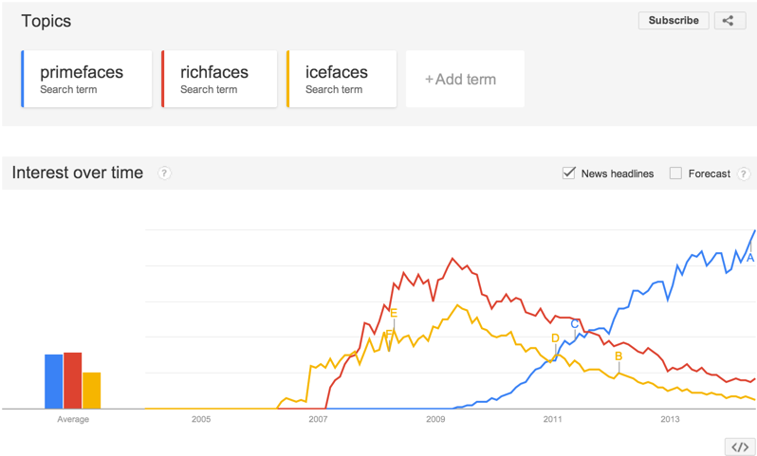
Popularity

Slide 11
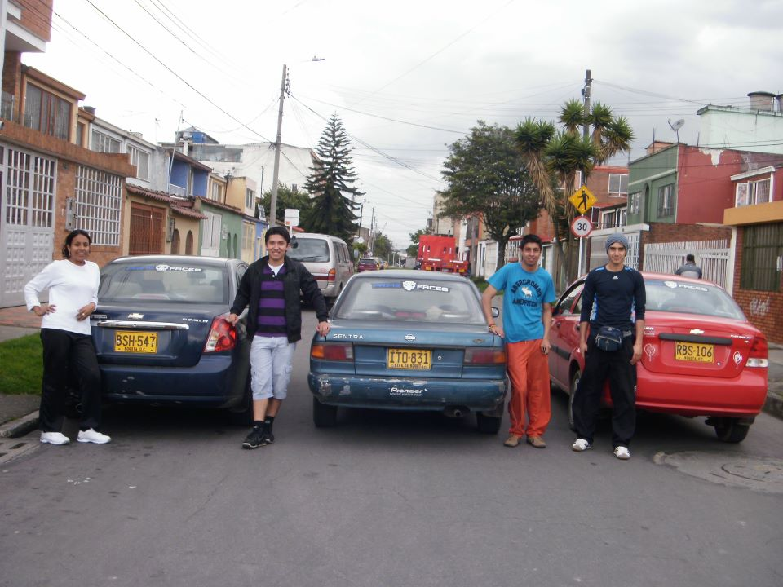
Global
Colombia

Slide 12
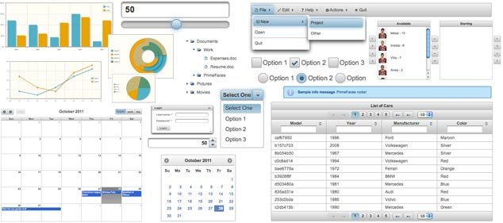
100+ UI Components

Slide 13
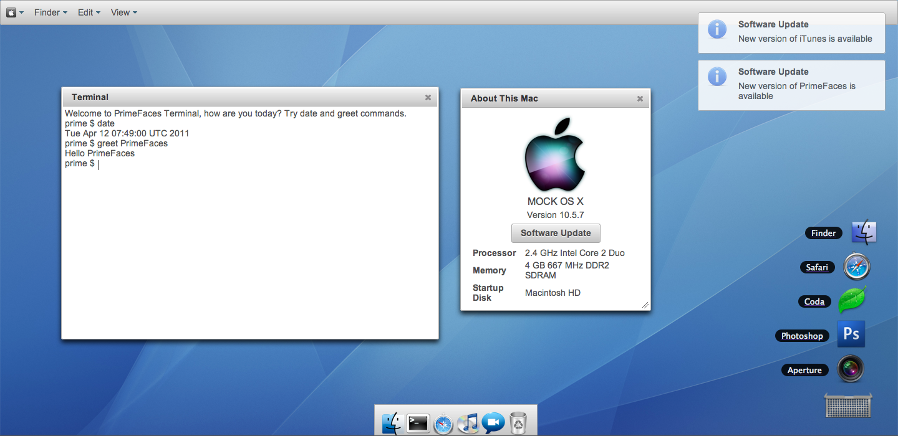
Advanced UIs

Slide 14
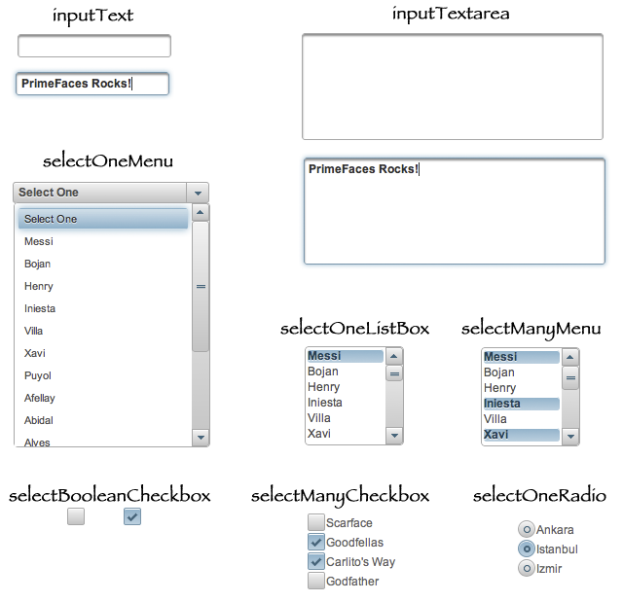
Form Components

Slide 15
Hide Complexity
CSS
JS
JSON
AJAX
Keep Flexibility
<p:tabView onTabChange=”handleTabChange()”>
<p:ajax event=”change” listener=”#{bean.onTabChange}” update=”comp” />
  //tabs
</p:tabView>
CSS
Override
JS
API
Client
Callbacks
Ajax
Callbacks

Slide 16
Anatomy of a Component
Page
<p:schedule id="schedule" value="#{scheduleView.eventModel}"
widgetVar="myschedule">
Markup
<div id=”form:sch”>
…
</div>
<script type=”text/javascript”>
$(function()
{PrimeFaces.cw("Schedule","myschedule",
{id:”form:schedule",widgetVar:"myschedule",defaultView:"month",
locale:"en”,offset:0,header:{left:'prev,next,today',
center:"title",right:"month,agendaWeek,agendaDay”},"schedule");});
</script>
Script

Slide 17
HTML5
data-*
canvas
websockets
forms
media

Slide 18

PrimeFaces Ajax
Server APIs: Standard JSF 2
Client APIs:

Slide 19
PrimeFaces Ajax
f:ajax
p:ajax
onevent
oncomplete
onerror
onerror
onstart
onsuccess
async
global

Slide 20
f:ajax
p:ajax
<f:ajax event=“blur” render=“userComponent” execute=“@this”/>
<p:ajax event=“blur” update=“userComponent” process=“@this”/>
a4j:ajax (RichFaces 3.x)
<a4j:support event=“blur” reRender=“userComponent”/>

Slide 21
Ajax Extensions
p:ajax
autoUpdate
Callbacks
Selectors
AjaxStatus
Request
Context
partialSubmit

Slide 22
AjaxStatus
<p:ajaxStatus>
<f:facet name=”start”>
<p:graphicImage value=”fancyanimation.gif” />
</f:facet>
<f:facet name=”complete”>
<h:outputText value=”Request Completed” />
</f:facet>
</p:ajaxStatus>
Declarative
Programmatic
<p:ajaxStatus onstart=”dialog.show()” oncomplete=”dialog.hide()” />
Global
<p:commandButton global=”true|false” />

Slide 23
RequestContext - Scripts
<p:commandButton value=”Submit” action=”#{bean.save}” />
<p:dialog widgetVar=”dialogWidget” ... />
Page
public void save() {
RequestContext rc = RequestContext.getCurrentInstance();
rc.execute(“PF(‘dialogWidget’).hide()”);
}
Bean

Slide 24
RequestContext - Update
Page
<p:commandButton value=”Submit” action=”#{bean.save}” />
<h:outputText id=”val” value=”#{bean.property}” />
public void save() {
RequestContext rc = RequestContext.getCurrentInstance();
rc.addPartialUpdateTarget(“val”);
}
Bean
or
<p:commandButton value=”Submit” action=”#{bean.save}”
        update=”val” />
<h:outputText id=”val” value=”#{bean.property}” />

Slide 25
RequestContext - Scroll
Page
<p:commandButton value=”Submit” action=”#{bean.save}” />
<h:outputText id=”val” value=”#{bean.property}” />
public void save() {
RequestContext rc = RequestContext.getCurrentInstance();
rc.scrollTo(“val”);
}
Bean

Slide 26
AutoUpdate
<p:growl id=”messages” />
<p:commandButton value=”Save” update=”messages” />
<p:commandButton value=”Update” update=”messages” />
<p:commandButton value=”Delete” update=”messages” />
<p:growl id=”messages” autoUpdate=”true”/>
<p:commandButton value=”Save” />
<p:commandButton value=”Update” />
<p:commandButton value=”Delete” />

Slide 27
PartialSubmit
False
True
Post Data:javax.faces.partial.ajax=true&javax.faces.source=form%3Aj_idt18&javax.faces.partial.execute=form%3Aname&javax.faces.partial.render=form%3Adisplay&form%3Aj_idt18=form%3Aj_idt18&form=form&form%3Aname=&form%3Aj_idt20=&form%3Aj_idt22=&form%3Aj_idt24=&form%3Aj_idt26=&form%3Aj_idt28=&form%3Aj_idt30=&form%3Aj_idt32=&form%3Aj_idt34=&form%3Aj_idt36=&form%3Aj_idt38=&form%3Aj_idt40=&form%3Aj_idt42=&form%3Aj_idt44=&form%3Aj_idt46=&form%3Aj_idt48=&form%3Aj_idt50=&form%3Aj_idt52=&form%3Aj_idt66=&form%3Aj_idt68=&form%3Aj_idt70=&form%3Aj_idt72=&form%3Aj_idt74=&form%3Aj_idt76=&form%3Aj_idt78=&form%3Aj_idt80=&form%3Aj_idt82=&form%3Aj_idt84=&form%3Aj_idt86=&form%3Aj_idt88=&form%3Aj_idt90=&form%3Aj_idt92=&form%3Aj_idt94=&form%3Aj_idt96=&form%3Aj_idt98=&javax.faces.ViewState=7916482521909421983%3A-2156051337299048496
Post Data:javax.faces.partial.ajax=true&javax.faces.source=form%3Aj_idt18&javax.faces.partial.execute=form%3Aname&javax.faces.partial.render=form%3Adisplay&form%3Aj_idt18=form%3Aj_idt18&form=form&form%3Aname=&javax.faces.ViewState=7916482521909421983%3A-2156051337299048496

Slide 28
PrimeFaces Selectors (PFS)
update=”@(form)”
update=”@(form.first)”
update=”@(.mystyle)”
update=”@(.ui-datatable)”
update=”@(:input:not(select))”
update=”@(:input:disabled))”

Slide 29
Resource Handling
Optimizations
On The Fly Loading
and
Minify
Merge
Compress

Slide 30
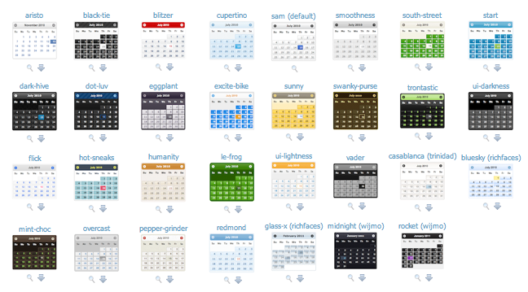
Themes

Slide 31


Install a Theme
Add primefaces-{themename}.jar
Configure
<context-param>
<param-name>primefaces.THEME</param-name>
<param-value>{themename}</param-value>
</context-param>

Slide 32
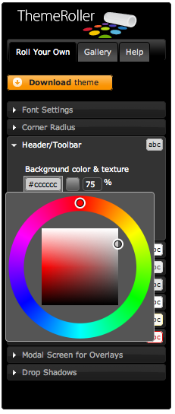
Roll Your Own

Slide 33
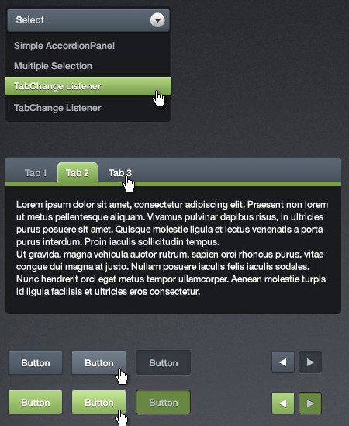
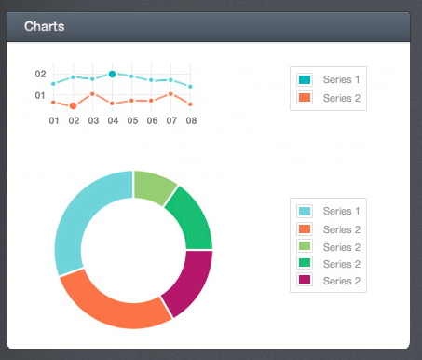
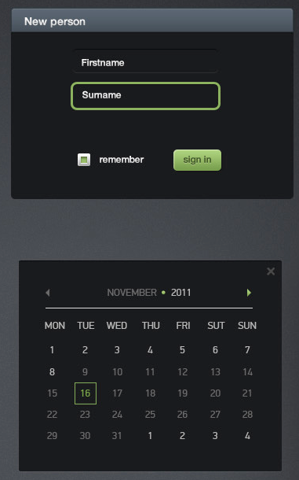
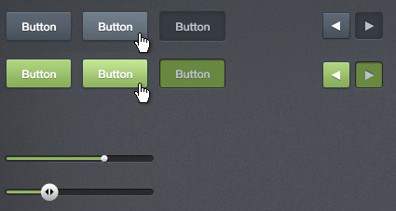
Advanced Themes

Slide 34

Demo:
Showcase
Notes:
DataTable, Sheet, Charts, Gmaps, Rating, MindMap, Input, Layout - Mailbox

Slide 35
Client-side Validation
<h:form>
<p:messages />
<p:inputText required="true" />
<p:inputTextarea required="true" />
<p:commandButton value="Save"
validateClient="true" ajax="false"/>
</h:form>

Slide 36
Instant Validation with Events
<h:form>
<h:panelGrid columns="4" cellpadding="5">
<h:outputLabel for="text" value="Text: (Change)" />
<p:inputText id="text" value="#{validationBean.text}" required="true">
<f:validateLength minimum="2" maximum="5" />
<p:clientValidator />
</p:inputText>
<p:message for="text" display="icon" />
<h:outputText value="#{validationBean.text}" />
<h:outputLabel for="integer" value="Integer: (Keyup)" />
<p:inputText id="integer" value="#{validationBean.integer}">
<p:clientValidator event="keyup"/>
</p:inputText>
<p:message for="integer" display="icon" />
<h:outputText value="#{validationBean.integer}" />
</h:panelGrid>
<p:commandButton value="Save" ajax="false" icon="ui-icon-check"
validateClient="true"/>
</h:form>

Slide 37
Client-side Validation
Messages are fully integrated
API for writing custom client-side validators and converters
Locale object available in JavaScript

Slide 38
Bean Validation Integration
public class Bean {
@NotNull
@Max(30)
private String name;
…
}
<p:inputText value="#{bean.firstname}" />
<input type="text" maxlength="30" … />

Slide 39
Other Features
JavaScript API
Accessibility
Right-to-left support
Exception handler
Dialog framework
Page authorization
PrimeFaces Extensions
…

Slide 40
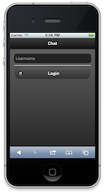
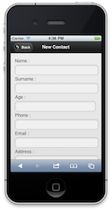
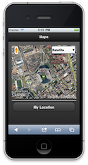
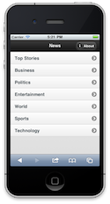
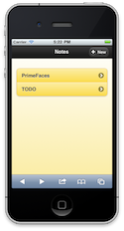
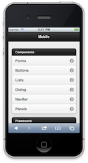
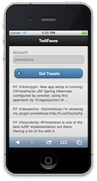
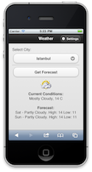
PrimeFaces Mobile

Slide 41
PrimeFaces Mobile
8 Core Components
20+ PrimeFaces Components
Gestures
Mobile navigation

Slide 42
PrimeFaces Mobile
<f:view renderKitId="PRIMEFACES_MOBILE" />
<h:head>
</h:head>
<h:body>
<pm:page id="main">
<pm:header title="Main Page"></pm:header>
<pm:content>
….
</pm:content>
</pm:page>
<pm:page id="second">
<pm:header title="Second Page"></pm:header>
<pm:content>
…
</pm:content>
</pm:page>
</h:body>

Slide 43


PrimeFaces Mobile

Slide 44
Demo: Mobile

Slide 45


PrimeFaces Push
JSF APP
PrimeFaces PushServlet

Slide 46

PrimeFaces Push
Atmosphere

Slide 47
PrimeFaces Push
<h:form>
<h:outputText value="#{counterView.count}" styleClass="display" />
<p:commandButton value="Click"
actionListener="#{counterView.increment}" />
</h:form>
<p:socket onMessage="handleMessage" channel="/counter" />
Page
public void increment() {
count++;
EventBus eventBus = EventBusFactory.getDefault().eventBus();
eventBus.publish("/counter", String.valueOf(count));
}
Bean

Slide 48
PrimeFaces Push
@PushEndpoint("/counter")
public class CounterResource {
@OnMessage(encoders = {JSONEncoder.class})
public String onMessage(String count) {
return count;
}
}
Endpoint
<script type=”text/javascript”>
function handleMessage(data) {
$('.display').html(data);
}
</script>
Callback

Slide 49
Demo: Push

Slide 50
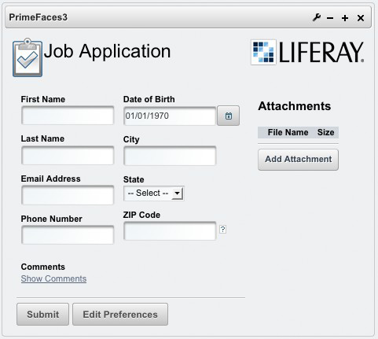

Portlets

Slide 51

Documentation
550+ Pages

Slide 52
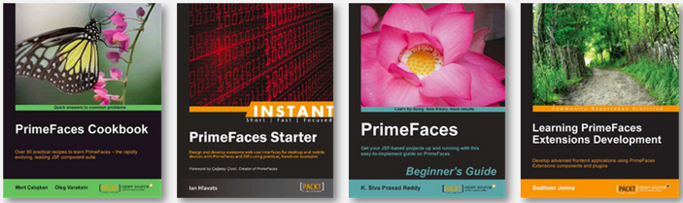
Books

Slide 53
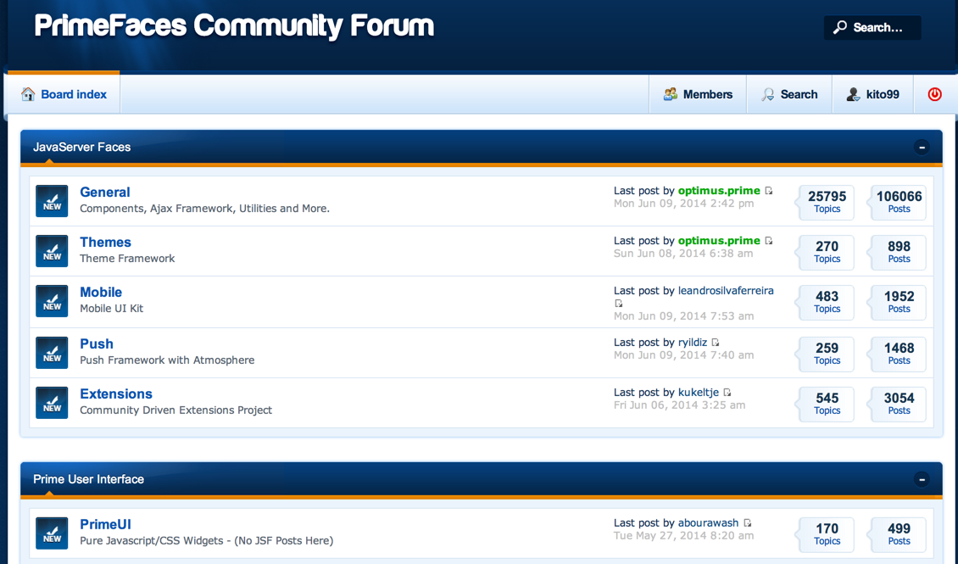
Community

Slide 54
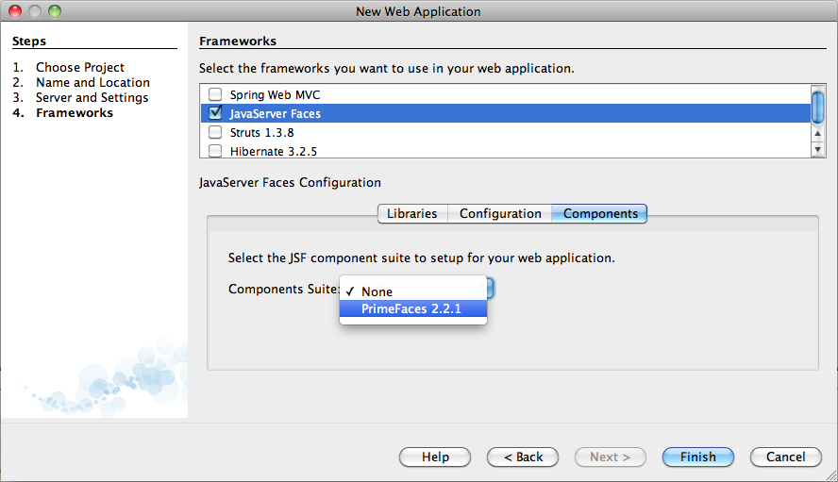
Bundled with NetBeans

Slide 55

Enterprise
PrimeTek Informatics
Support
Training
Consulting

